Slide 1


Department of BES-I
COURSE: Data Structures
COURSE CODE: 24SC1203
Topic:
Name of the topic:
BFS
Session – 36

Slide 2



AIM OF THE SESSION
To familiarize students with the basic concept of BFS.
INSTRUCTIONAL OBJECTIVES
This Session is designed to:
Demonstrate the BFS.
Apply BFS to Real-World Problems.
Describe the each operation
List out the advantages and disadvantages with BFS.
LEARNING OUTCOMES
At the end of this session, you should be able to:
Define BFS
Describe the BFS and its operations
Summarize definition, and operations of BFS, its applications

Slide 3
BFS - INTRODUCTION
Breadth-First Search (BFS) is a fundamental graph traversal algorithm used to explore and analyze graphs and trees in a systematic manner. It starts from a specified source vertex and visits all the vertices in the graph, level by level, before moving to the next depth level.
This approach ensures that vertices at lower levels are visited before vertices at deeper levels, making BFS particularly useful for finding the shortest path between nodes and solving problems where proximity matters.
Traversal means visiting all the nodes of a graph. Breadth First Traversal or Breadth First Search is a recursive algorithm for searching all the vertices of a graph or tree data structure.

Slide 4
BFS Algorithm
A standard BFS implementation puts each vertex of the graph into one of two categories:
          Visited
          Not Visited
The purpose of the algorithm is to mark each vertex as visited while avoiding cycles.
The algorithm works as follows:
Step 1: Start by putting any one of the graph's vertices at the back of a queue.
Step 2: Take the front item of the queue and add it to the visited list.
Step 3: Create a list of that vertex's adjacent nodes. Add the ones which aren't in the visited list to the back of the queue.
Step 4: Keep repeating steps 2 and 3 until the queue is empty.
Step 5: The graph might have two different disconnected parts so to make sure that we cover every vertex, we can also run the BFS algorithm on every node

Slide 5
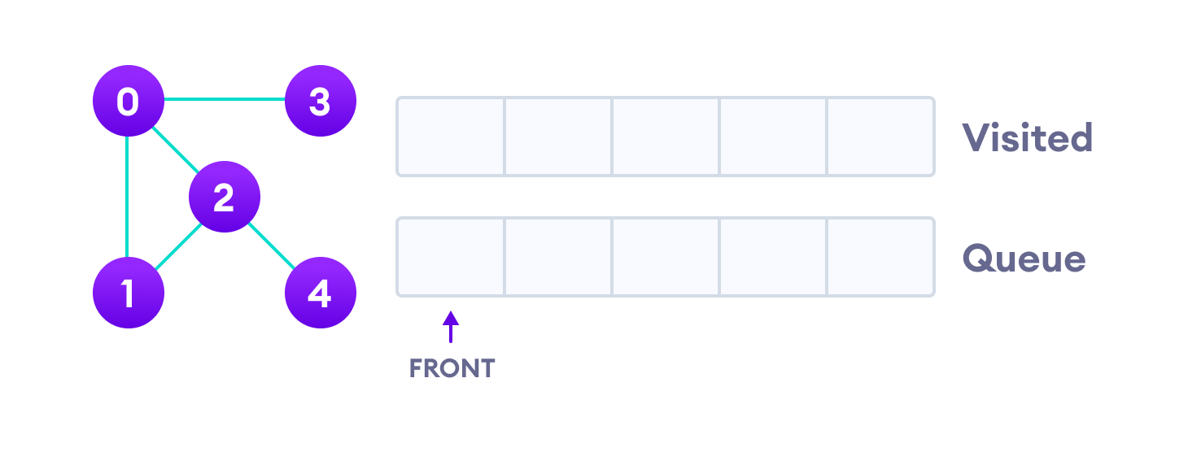
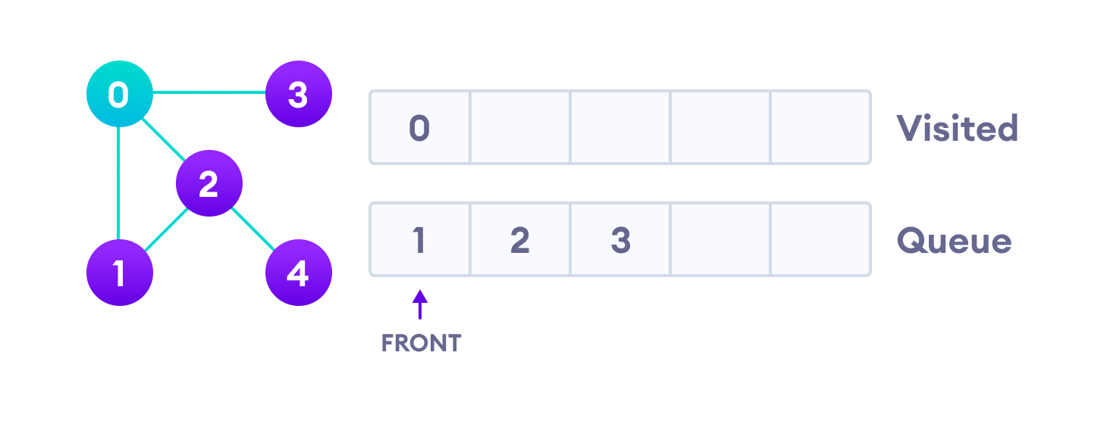
Example of BFS
Undirected Graph with Vertices
We start from vertex 0, the BFS algorithm starts by putting it in the Visited list and putting all its adjacent vertices in the stack.
Visit start vertex and add its adjacent vertices to queue

Slide 6
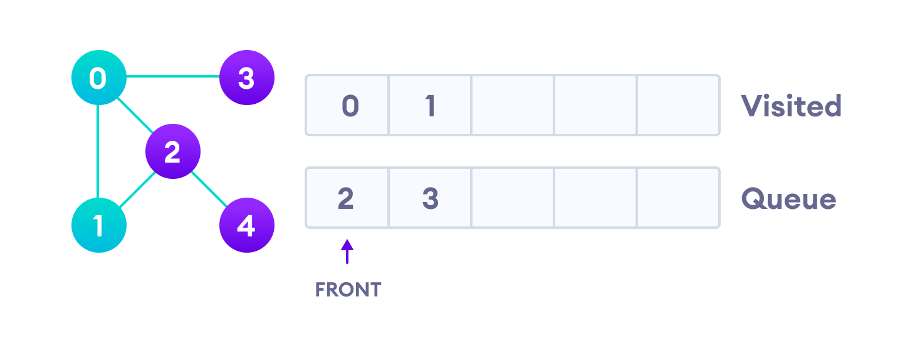
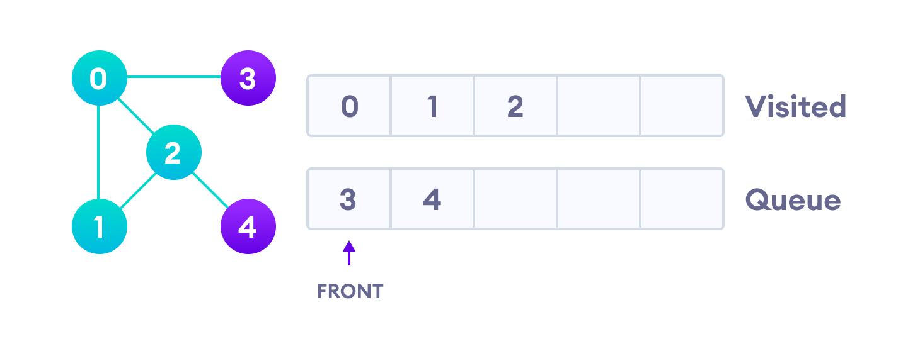
Cont…
Next, we visit the element at the front of queue i.e. 1 and go to its adjacent nodes. Since 0 has already been visited, we visit 2 instead.
Visit the first neighbor of start node 0, which is 1
Vertex 2 has an unvisited adjacent vertex in 4, so we add that to the back of the queue and visit 3, which is at the front of the queue.
Visit 2 which was added to queue earlier to add its neighbors

Slide 7
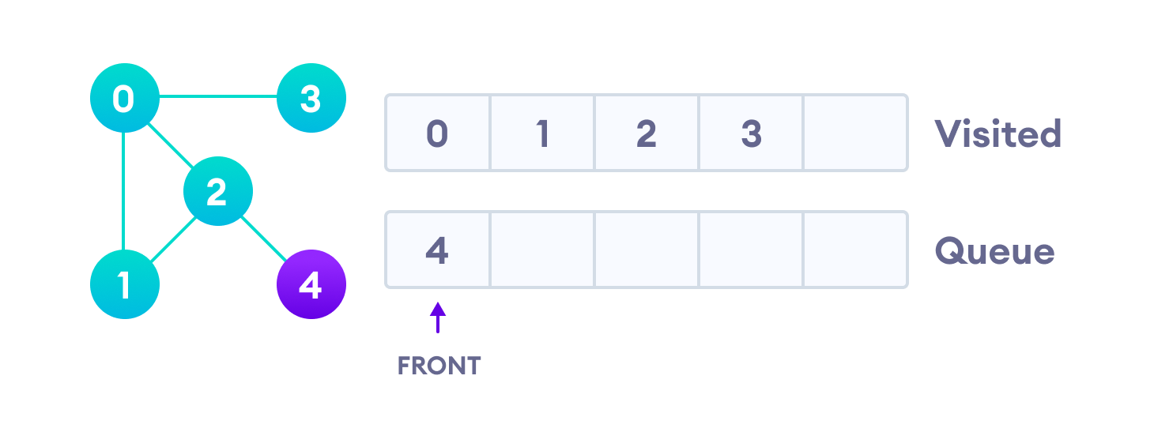
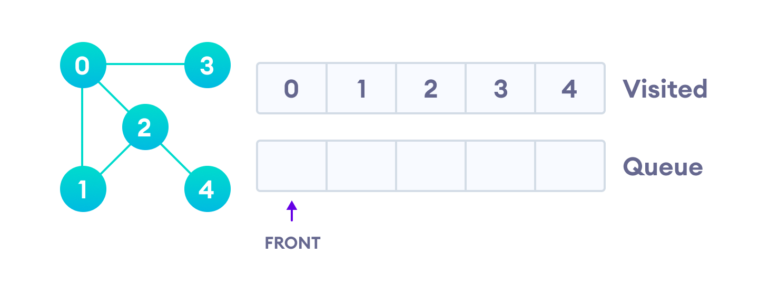
(Cont..)
4 remains in the queue
Only 4 remains in the queue since the only adjacent node of 3 i.e. 0 is already visited. We visit it.
Visit last remaining item in the queue to check if it has unvisited neighbors
Since the queue is empty, we have completed the Breadth First Traversal of the graph.

Slide 8
BFS Algorithm Complexity
The time complexity of the BFS algorithm is represented in the form of O(V + E), where V is the number of nodes and E is the number of edges.
The space complexity of the algorithm is O(V).
IMPORTANT FACTS RELATED TO THE SESSION-BFS
BFS Algorithm Applications
To build index by search index
For GPS navigation
Path finding algorithms
In Ford-Fulkerson algorithm to find maximum flow in a network
Cycle detection in an undirected graph

Slide 9
SELF-ASSESSMENT QUESTIONS
Breadth First Search is equivalent to which of the traversal in the Binary Trees?
a) Pre-order Traversal
b) Post-order Traversal
c) Level-order Traversal
d) In-order Traversal
2. Traversal of a graph is different from tree because?
There can be a loop in graph so we must maintain a visited flag for every vertex
DFS of a graph uses stack, but inorder traversal of a tree is recursive
BFS of a graph uses queue, but a time efficient BFS of a tree is recursive.
All of the above

Slide 10
a) O(E)
b) O(V + E)
c) O(V)
d) O(V^2)
a) O(E)
b) O(V + E)
c) O(V)
d) O(V^2)
a) Stack
b) Queue
c) Linked List
d) Array
a) Stack
b) Queue
c) Linked List
d) Array
a) Stack
b) Queue
c) Linked List
d) Array
a) Stack
b) Queue
c) Linked List
d) Array
SELF-ASSESSMENT QUESTIONS
3. What is the space complexity of BFS?
a) O(E)
b) O(V + E)
c) O(V)
d) O(V^2)
4. Which data structure is primarily used in the BFS algorithm?
Stack
Queue
c) Linked List
d) Array

Slide 11
TERMINAL QUESTIONS
1. Describe the Breadth First Search (BFS) in a graph or tree?
2. Describe the BFS algorithm work in a C program?
3. Can BFS be used to search in un weighted and weighted graphs?
4. What are the space and time complexities of BFS?
5. How does BFS handle disconnected graphs?
6. When would you use BFS?

Slide 12
REFERENCES FOR FURTHER LEARNING OF THE SESSION
Reference Books:
  Mark Allen Weiss, Data Structures and Algorithm Analysis in C, 2010 , Second Edition, PearsonEducation.
  2. Ellis Horowitz, Fundamentals of Data Structures in C: Second Edition, 2015
  A.V.Aho, J. E. Hopcroft, and J. D. Ullman, “Data Structures And Algorithms”, Pearson Education, First Edition Reprint2003.
Sites and Web links:
1. https://nptel.ac.in/courses/106102064
2. https://in.udacity.com/course/intro-to-algorithms--cs215
3. https://www.coursera.org/learn/data-structures?action=enroll

Slide 13
THANK YOU
Team – Data Sructures

